Slide 1
ANGIOSPERMS
The angiosperms form the largest and most diverse division of the plant kingdom with more than 250,000 species.
They are flowering plants and dominate the vegetation on land.
The word Angiosperm is derived from two Greek words: angeion - “vessel” and sperma - “seed.
The main distinguishing features of the angiosperms are the flowers, fruits and distinctive life cycle.
They are the largest group of photosynthesizing plants containing both chlorophylls ‘a’ and ‘b’ and accessory pigments.
The vegetative form (sporophytic stage) of angiosperms is the dominant form and consists of leaves, stems and roots.

Slide 2
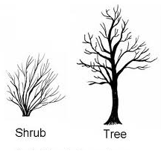
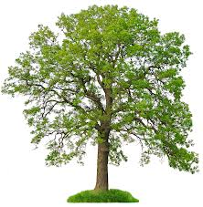
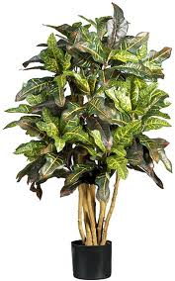
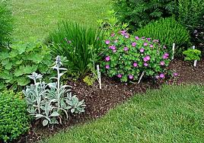
There is great diversity in the vegetative forms;
Trees with upright trunks (size >100m in height, 20m in girth as seen in the Eucalyptus sp.),
Shrubs that form branches from the ground level
Herbs are non woody annual, biennial, or perennial plants
Vines are flexible stemmed plants which use other plants for support to grow into the sunlight They may be woody (lianas) or herbaceous (climbers/creepers)
Epiphytes
herbs
tree
shrub

Slide 3
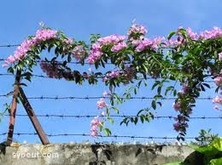
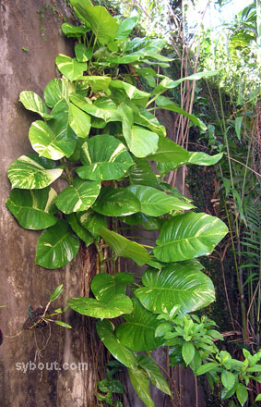
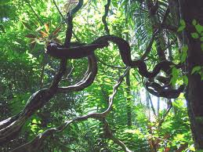
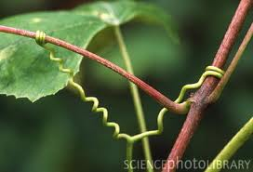
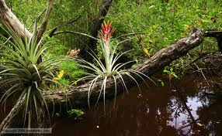
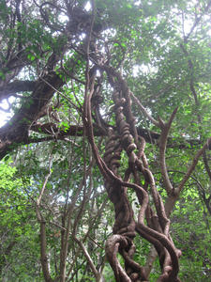
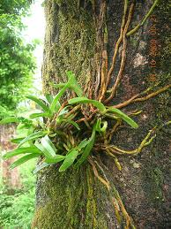
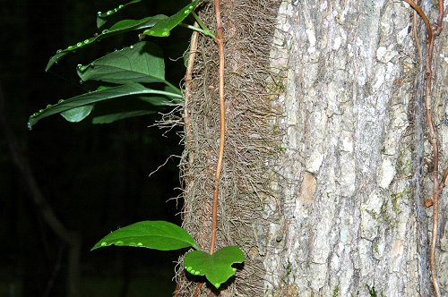
climbers
lianas
epiphytes
tendril climber
root climber

Slide 4
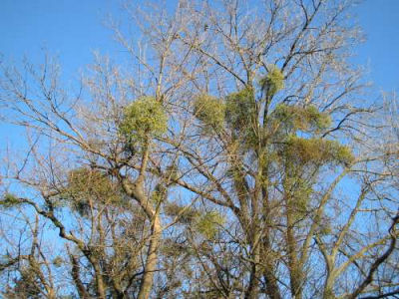
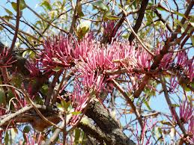
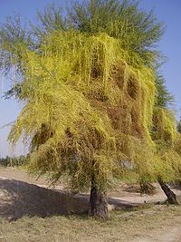
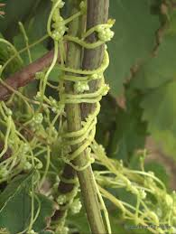
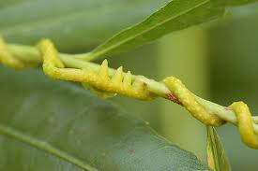
Habitat
Angiosperms can be found in different habitats. They may be terrestrial or aquatic.
Nutrition
Most species are autotrophic, thus photosynthetic. Few are parasitic e.g. Tapinanthus sp. and Cuscata sp. and absorb nutrients from the host plant through haustoria that penetrate the host tissues.
Tapinanthus sp.
Cuscuta sp.

Slide 5
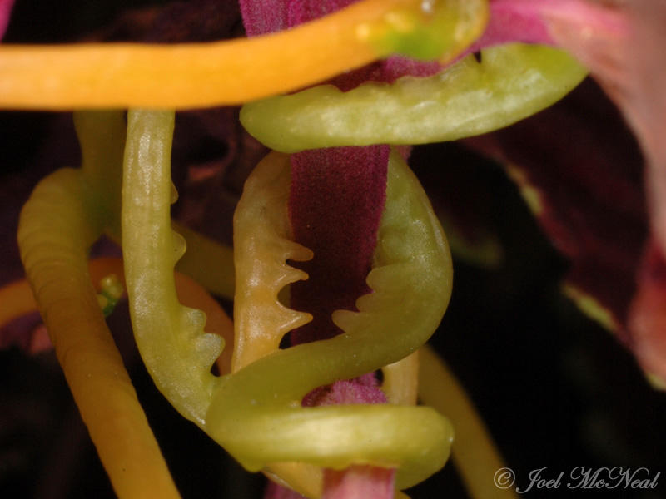
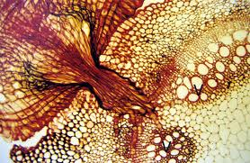
Cuscuta Haustoria
T.S. of Cuscuta Haustoria penetrating host vascular tissue to draw out nutrition

Slide 6
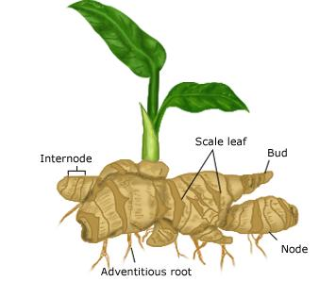
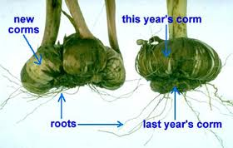
Reproduction
There is alternation of vegetative and reproductive phases.
Reproduction in angiosperms can be vegetative or sexual. Vegetative reproduction can be by special organs (rhizomes, corms, suckers, stem cuttings, leaf, etc.)
Bulb
Rhizome

Slide 7
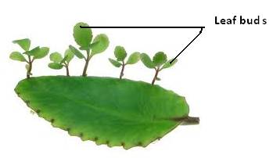
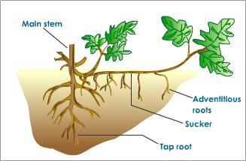
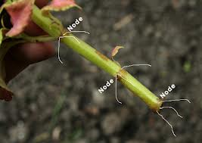
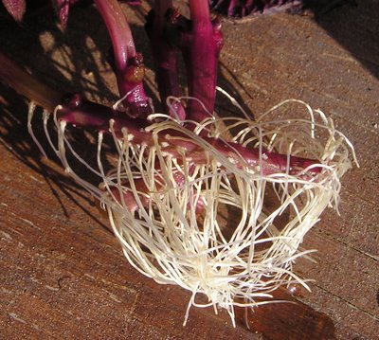
Propagation by leaf
Sucker
Stem cuttings

Slide 8
Angiosperm flower
Flowers of angiosperms are specialized reproductive structures.
They are made up of four main parts – Sepals, Petals, Stamens and Carpels.
The flowers may be found at the ends of branches or in the axils of leaves.
They may or may not be conspicuous. Conspicuous flowers have floral parts - sepals and petals which are coloured and attractive.
Plants may have only male or female flowers– dioecious; or have both the males and female flowers on the same plant but on different branches – monoecious ; or have both male and female reproductive structures on the same flower – hermaphroditic.

Slide 9
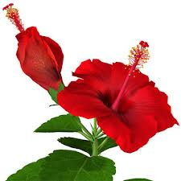
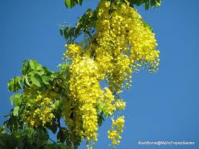
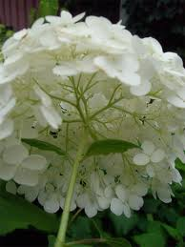
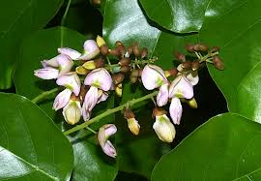
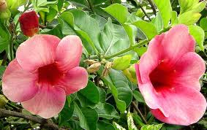
Solitary flowers
Inflorescence

Slide 10
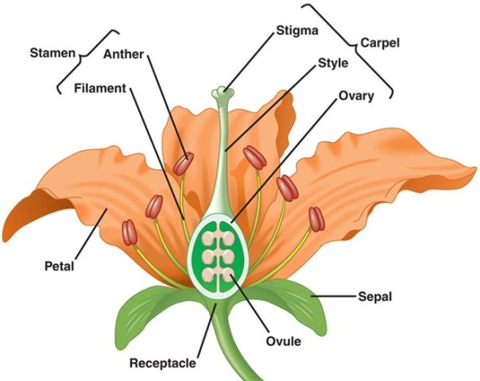
Flower Parts
Perfect Flower

Slide 11
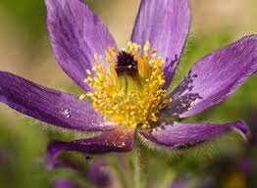
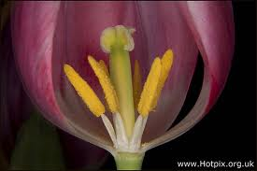
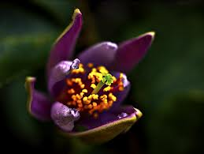
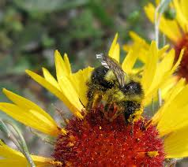
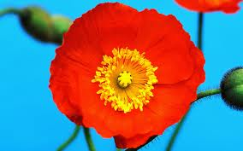
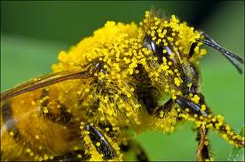

Slide 12
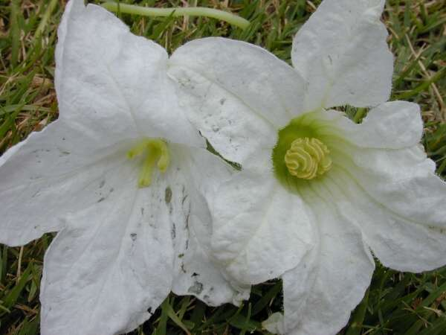
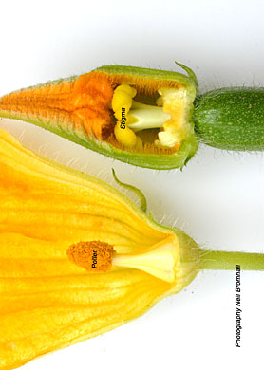
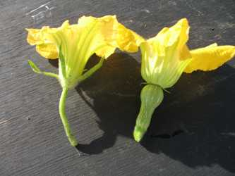
Male flower
Female flower
LS of Male flower
LS of Female flower

Slide 13
The male reproductive structures are the stamens which produce and bear the pollen that contain the male gametes.
The female reproductive structures are the carpels which consist of the stigma, style and ovary. The ovary contains the ovules which are the female gametes.
Another peculiarity of angiosperms is that they undergo double fertilization. One sperm fertilizes the egg to form a diploid zygote and the other sperm fertilizes the two polar nuclei to form a polyploid endosperm.
The zygote develops into the embryonic axis and the storage tissue. Angiosperms form true seeds that are enclosed by other reproductive tissues to form the fruit.

Slide 14
All angiosperms belong to the single division Magnoliophyta which is divided into two classes; the Magnoliopsida previously known as Dicotyledons and the Liliopsida which were referred to as Monocotyledons.
CLASS LILIOPSIDA (MONOCOTS)
Monocots are usually herbaceous with less than 10% being woody.
Mostly the woody stem is usually of uniform diameter throughout the length of the plant.
Leaves are sessile (do not have petioles i.e. leaf stalk), mostly long and slender with parallel veins. Leaves have extensions at the base known as leaf sheaths that clasp and cover the internodal region of the shoot.
The mature root system is completely adventitious.
Monocot seeds possess a single cotyledon – hence the name monocotyledon.
Floral parts occur in threes or multiples of three.
Majority of the monocots are perenial herbs with persistent underground stems that may be horizontal rhizomes or vertical corms. Reproduction in the Liliopsida is both vegetative and sexual.

Slide 15
The Magnoliopsida (Dicotyledon)
The stems are branched.
The leaves are petiolate or stalked and are generally broad with reticulate venation.
Seeds contain two cotyledons.
A few of the dicots have endosperm as the main storage tissue.
They can be herbaceous and woody. The woody forms usually undergo secondary growth.
The tap root system is prominent in dicots.
The floral parts are in multiple of four or five

Slide 16
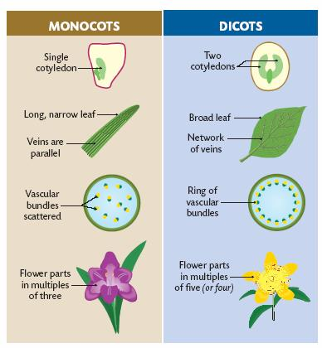
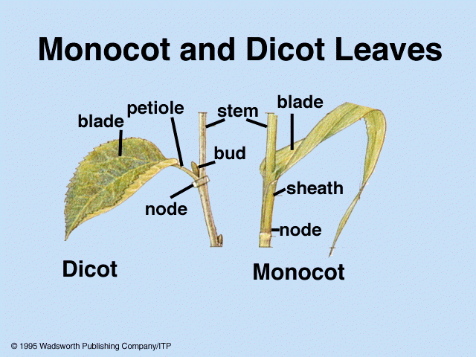
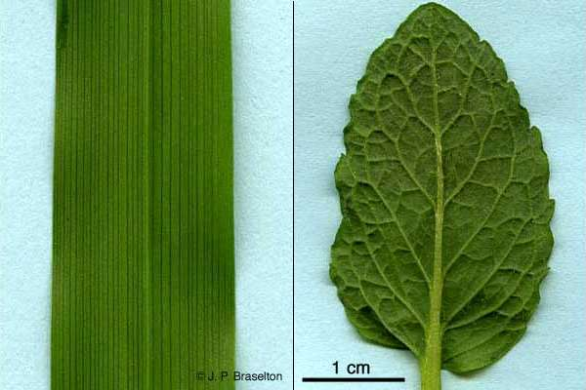
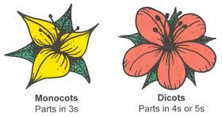

Slide 17
ECONOMIC IMPORTANCE OF ANGIOSPERMS
As food:
They are consumed directly as food e.g. cereals, pulses (legumes), fruits, vegetables, roots and tubers, or indirectly in food and beverage industry e.g. essences (vanilla), malted cereals for beer.
As fibers:
They provide fibres for clothing, ropes, etc. For e.g. Cotton (Gossypium sp.), Jute (Corchorus capsularis and C. olitorius), Sisal hemp (Agave sisalana), Linen (Linum usitatissimum).
As medicine:
Organic compounds synthesized (alkaloids, glycosides) by plants are used in treating various ailments. E.g. Artemissin used in treating malaria.
As Constructional material:
Wood of various angiosperms is used for construction of buildings, railways, ships, and furniture. E.g. Teak (Tectona grandis).
As Rubber:
The latex of few angiosperms used in various industrial processes e.g. tyre-making from the rubber plant (Hevea sp.)
As Essential oils:
The essential oil obtained from flowers, fruits, seeds, leaves, etc. are used in cosmetic industry.
As Horticulture - Ornamental, landscaping and restoration of ecosystem.

